Slide 1
Testing Project
CSE 4321, Spring 2018

Slide 2
Motivation
Provides an opportunity to practice the basic concepts, principles, and techniques covered in this course
In particular, you will apply control flow testing to a program of moderate size
Printtokens.java: a Java class that implements a string tokenizer.
about 500 lines of code and with 15 seeded faults

Slide 3
Program Description
Input:
Location of a file (input for main() method) that contains yet to be classified content
If a location is not given, an empty string is provided for the main() method. An input stream will be created for user to input yet to be classified content in the console.

Slide 4
Program Description
Type of classification:
Keyword:
List of Keywords: and, or, if, xor, lambda, =>
Special Symbol:
List of Special Symbols: “(”, “)”, “[”, “]”, “’” ,”`”, “,”. (lparen, rparen, lsquare, rsquare, quote, bquote, comma)
Identifier:
Examples: a, aa, a1, a2, etc. (Identifiers start with a letter, contain only letters and digits)
Number Constant:
Examples: 123, 1, 321
String Constant:
Examples: “asd”, “123”, etc. (Strings are surrounded by “”)
Character Constant:
Examples: #a, #b, #c, #d, etc
Comment:
Anything starts with “;”.
Error:
Everything else.

Slide 5
Program Description
Classification, “original input”
Or
Special Symbol
Output Format:
Example:
Input:
Output:
and`and
j
112A
keyword,"and".
bquote.
keyword,"and".
identifier,"j".
error,"112A".

Slide 6
Steps
Draw control flow graphs(CFG) for each method.
Come up with test cases for each of the selected methods to achieve edge coverage, including main method.
Use JUnit to implement and execute the identified test cases.
Provide the code coverage report(lines, branches) for tests from:
All the methods beside main method. (Focusing on covering as much code as possible for each method)
Only the main method itself. (End to end test, focusing on covering as much code as possible for the whole program)
Total of 18 methods. The following 3 methods can be skipped.
get_char()
unget_char()
unget_error()
Catch clauses of the program can be skipped.

Slide 7
Deliverables
Final Report, Due by May 4th (midnight), 2018
20% CFGs that also contains screenshot of method source code, and basic block table that identifies each basic block.
35% Test data (Test file?)of each test case from each method that achieves edge coverage of the CFGs, also the covered edges of each corresponding testing case (Test Paths?).
20% JUnit source code.
5% 2 HTML Code Coverage reports from previous description. Generated using JaCoCo
10% Faults detected and corrections.
5% Summary and discussion.
5% Read me.txt that explains how your JUnit source code can be executed.

Slide 8
Must have files
CFG.pdf(20%)
Test Paths and Data.pdf(20%)
Faults Detected and Corrections.pdf(10%)
Code Coverage Report.pdf(5%)
Summary and Discussion.pdf(5%)
Read me.txt(5%)
Source Code(35%)

Slide 9
Evaluation
Faults detected and code coverage are not the only evaluation metrics, because they are hard to control.
If followed edge coverage when creating test cases, you should detect at least 10 bugs.
Focus on the correctness of the CFGs and test cases that supposed to achieve edge coverage and the implementation of Junit test cases.

Slide 10
Recommendations
NetBeans
Code Coverage – JaCoCo/Eclema

Slide 11
Practical Issues
Draw a CFG for each method that has branches.
Collect test paths for each CFG to achieve edge coverage.
A test path may not be feasible and may need to be replaced
Generate test data for each test path.
Fix each fault you find before looking for the next fault

Slide 12
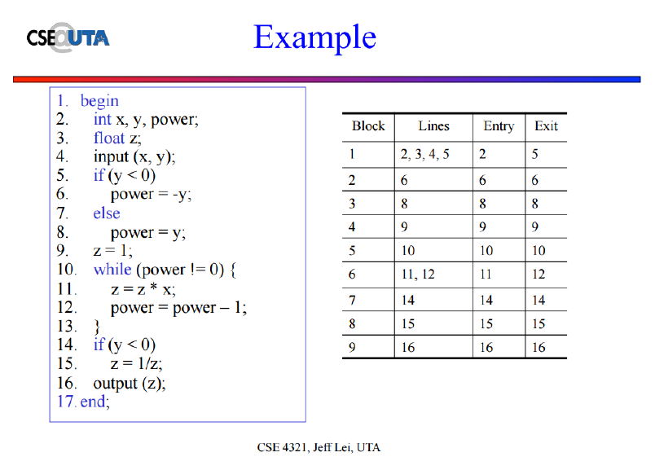
Basic Block Table

Slide 13
Q&A

